Slide 1

Welcome

Slide 2

Laptop Price Prediction
This project uses machine learning to predict laptop prices, aiming to create an accurate model for informed consumer and seller decisions.

Slide 3


Laptop Price Prediction
Introduction
Guidance
This project aims to provide insights into the pricing of laptops in the market.
Guidance by Priyanka mam.

Slide 4



Using ML for Laptop Price Prediction
ML Analysis
2
ML finds patterns for accurate price forecasting.
Types of Laptops
1
The variety of laptops makes pricing complex for consumers.
Data-Driven Methods
The project improves laptop price prediction accuracy using data methods.
3

Slide 5




Data Analysis Steps
1
2
3
4
5
Data Cleaning
Exploratory Data Analysis
Data Preprocessing
Model Building
Model Evaluation
Fixing dataset errors.
Analyzing data patterns.
Building and training models.
Evaluating model performance.
Formatting data for modeling.
6
7
Model Improvement
Web Development
Building a Streamlit web app.
Tuning models for accuracy.

Slide 6



Data Cleaning Process
Data cleaning removes outliers and handles missing values to ensure accurate results. Techniques like imputation or record removal help maintain data integrity for reliable models.
Outlier Removal
Missing Value Handling
Data Integrity Assurance
Removing skewed data points.
Imputation or record removal techniques are applied.
Essential for reliable prediction models.

Slide 7




Exploratory Data Analysis (EDA)
Key Metrics Analysis
Key metrics such as average price, brand influence, and feature importance are analyzed.
Data Visualization
Guiding Insights
EDA involves visualizing data through graphs and charts to identify trends and correlations.
Insights gained from EDA guide feature selection for the modeling phase.
2
1
3

Slide 8
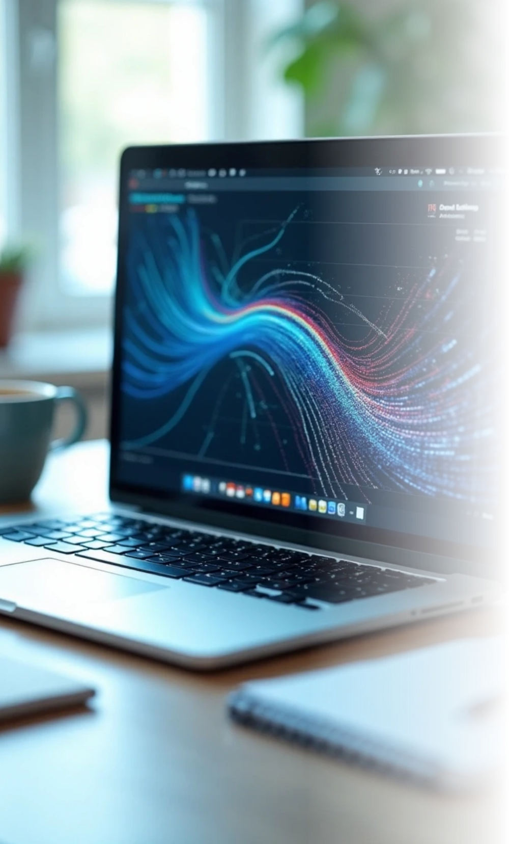

Model Building and Evaluation
1
Algorithms Tested
Several machine learning algorithms are tested for price prediction.
2
Performance Evaluation
Each model's performance is evaluated to choose the best-suited algorithm.
3
Model Generalization
The evaluation ensures the model performs well on unseen data.

Slide 9
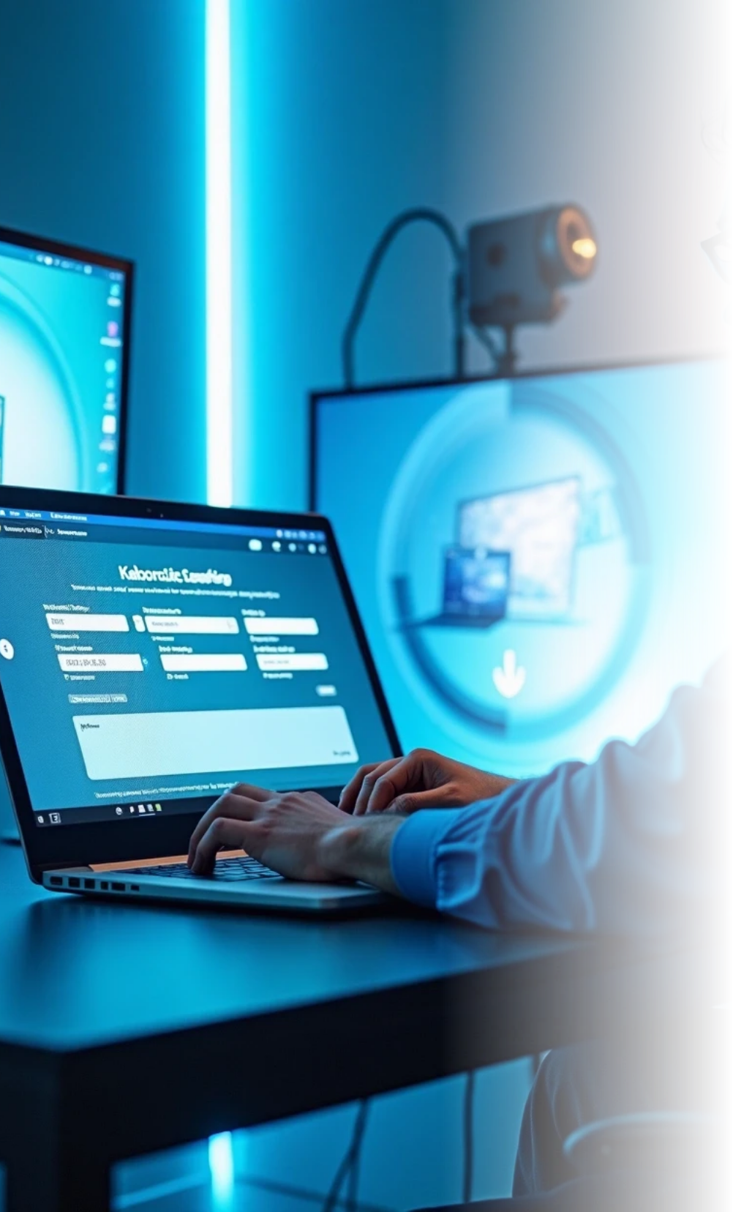
Improvement and Deployment
Model Optimization
Hyperparameter tuning and feature engineering are applied for optimization.
Web Application Integration
The final model is integrated into a Streamlit web application for usability.
User Interaction
Users can input laptop specifications and receive price predictions instantly.

Slide 10



Thank You for Your Attention
Insights Provided
2
We hope this presentation provided valuable insights into the project’s objectives and methodologies.
Project Appreciation
Thank you for your attention and interest in the Laptop Price Prediction project.
1
Further Inquiries
3
For further inquiries or discussions, please feel free to reach out.

